Slide 1
Providing Privacy, Safety, and Security in IoT-Based Transactive Energy Systems using Distributed Ledgers
Abhishek Dubey Vanderbilt University | Aron Laszka University of Houston
in partnership with Siemens, CT

Slide 2
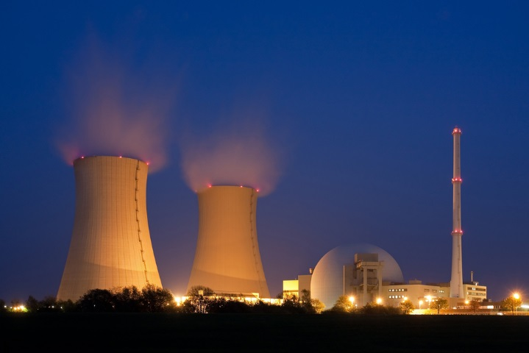

Electrical Energy Networks are Changing
From centralized to decentralized and distributed energy systems
Changing Generation Mix
Transactive Energy
Electric Cars
Decentralization
DER-s
Increasing Complexity

Slide 3
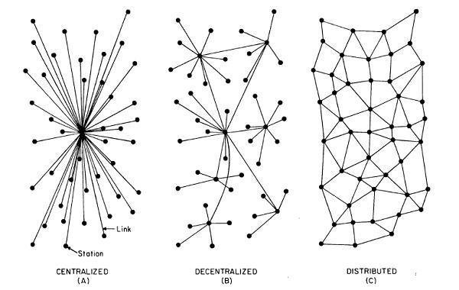
The Evolution of Energy Networks
Traditional networks with transmission system operators, distribution system operators, and radial distribution systems to communities

Slide 4
The Evolution of Energy Networks
Advantages of decentralization
improved cyber and physical reliability by removing single point of failures
faster decision making by avoiding network penalties due to round-trip to the cloud
improved scalability
better integration with hierarchical control systems
Traditional networks with transmission system operators, distribution system operators, and radial distribution systems to communities
Network of distribution feeders with some microgrids with tightly integrated distributed energy resources

Slide 5
The Evolution of Energy Networks
Trend
Traditional networks with transmission system operators, distribution system operators, and radial distribution systems to communities
Network of distribution feeders with some microgrids with tightly integrated distributed energy resources
Network of transactive microgrids with limited role of distribution system operators

Slide 6
Smart Homes with Production and Delayed Consumption Capability are the Key to this New Trend of Transactive Energy

Slide 7
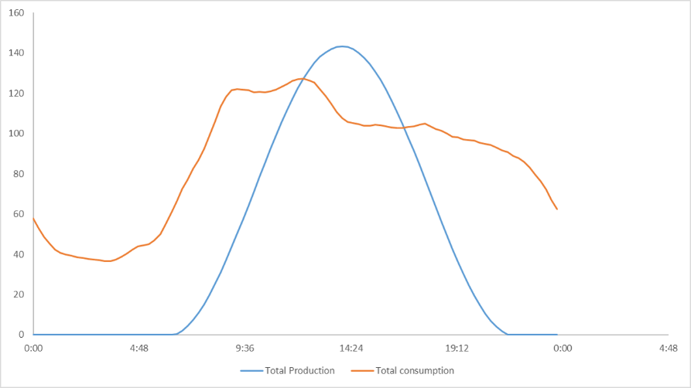
Transactive Energy: Smart Homes → Smart Prosumers
Participant 1
Energy Exchange
Reduces Dependence on the Grid
Participant 2
typical generation and consumption profile

Slide 8
Transactive Energy Challenges
Challenges:
Local energy market safety and efficiency
time synchronized distributed IoT platforms problem
Integrity and auditability of finalized transactions
decentralized management problem
Information privacy for prosumers
distributed protocol problem
Energy Exchange
Reduces Dependence on the Grid

Slide 9
Focus Challenge: Privacy
Example: residents leave their house for the evening
Information privacy
leakage of energy usage patterns to other prosumers
inference of future states from prosumer transactions
transactions and energy usage data in a transactive microgrid are much richer sources of information than the simple usage data collected by smart meters
1. smart home decides to sell surplus energy
2. smart home posts offer to sell energy future
3. other prosumers in the microgrid learn that the residents will not be home

Slide 10
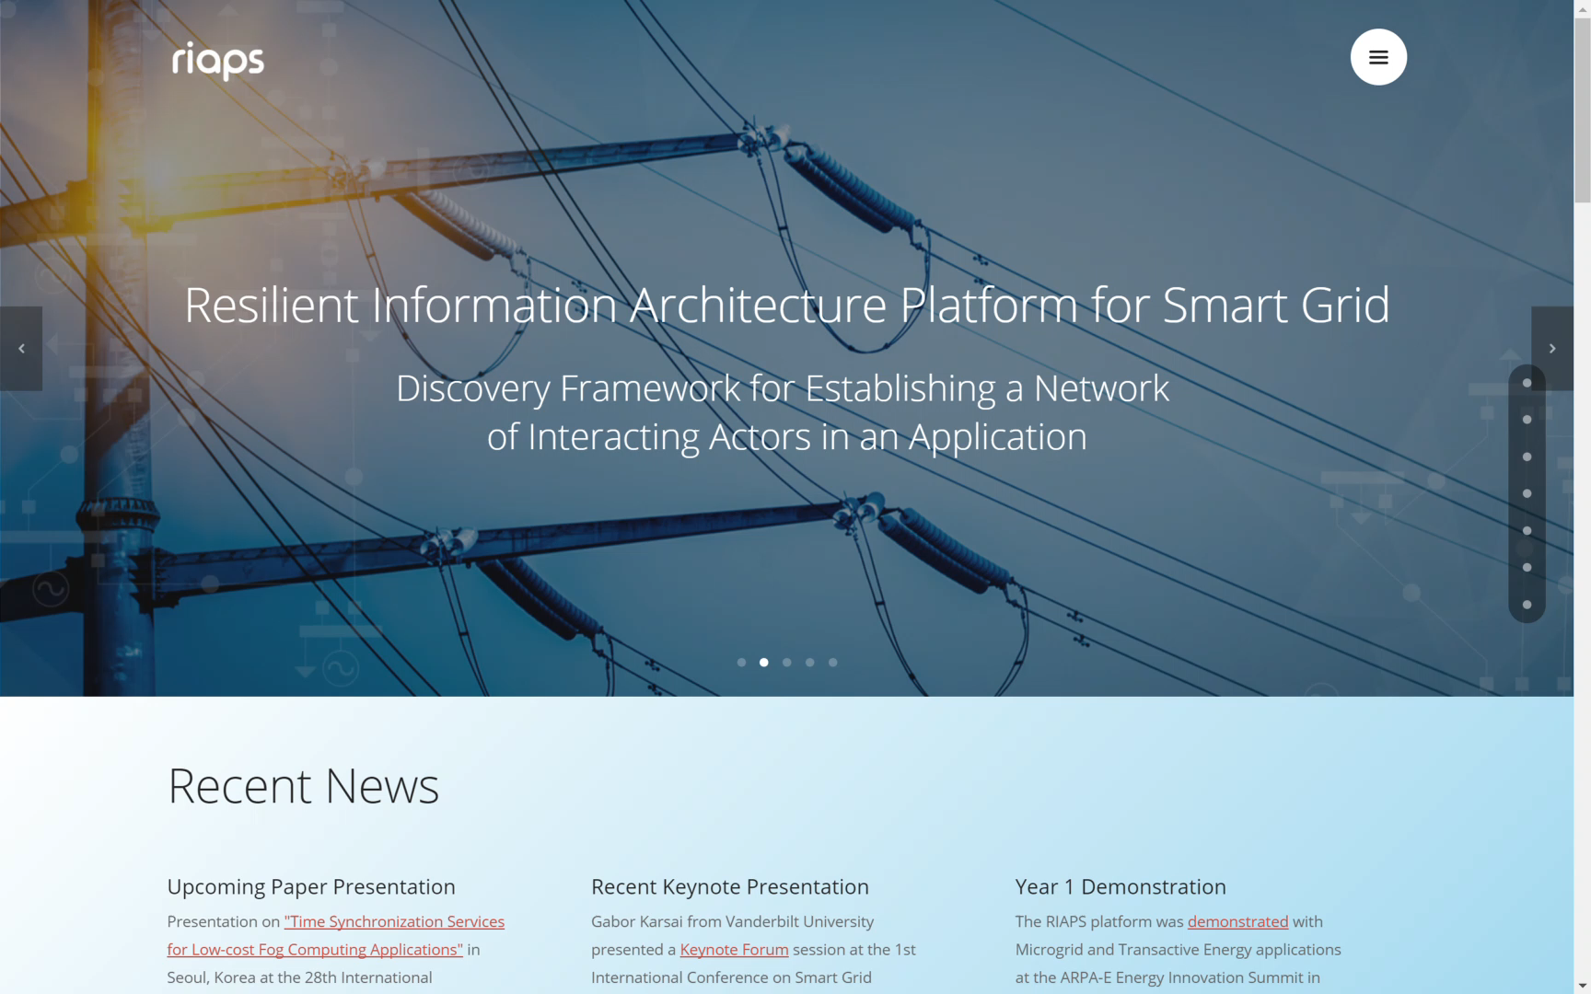
RIAPS: Our IoT Programming Architecture
programming model (for distributed real-time software) on embedded nodes dispersed throughout the power grid
services (for application management, fault tolerance, security, time synchronization, coordination, etc.)
PI: Gabor Karsai, Vanderbilt university, http://riaps.isis.vanderbilt.edu
http://riaps.isis.vanderbilt.edu

Slide 11
The PETra System Components

Slide 12
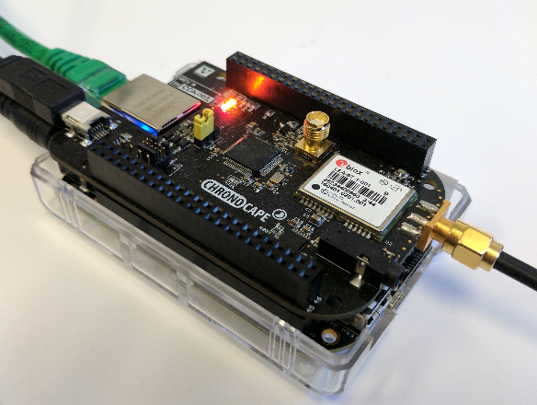
PETra Trading Platform and Distributed Ledger Architecture
We introduce PETra, a blockchain-based solution that enables consumers to trade energy without sacrificing their privacy and provides safety and security for the grid. It provides the following:
The node runs the necessary logic to participate in the trading
A RIAPS Node Participating in PETra-Enabled Transactive Energy Market

Slide 13
PETra Trading Platform and Distributed Ledger Architecture
We introduce PETra, a blockchain-based solution that enables consumers to trade energy without sacrificing their privacy and provides safety and security for the grid. It provides the following:
Bid Storage
by serving as a database for bids, enables prosumers to find trade partners without communicating with all potential partners
PETra

Slide 14
PETra Trading Platform and Distributed Ledger Architecture
We introduce PETra, a blockchain-based solution that enables consumers to trade energy without sacrificing their privacy and provides safety and security for the grid. It provides the following:
Bid Storage
Distributed Ledger
by serving as a database for bids, enables prosumers to find trade partners without communicating with all potential partners
stores transactions that specify trades, energy production and consumption values, financial records, and regulatory policies for the microgrid
PETra

Slide 15
PETra Trading Platform and Distributed Ledger Architecture
We introduce PETra, a blockchain-based solution that enables consumers to trade energy without sacrificing their privacy and provides safety and security for the grid. It provides the following:
Bid Storage
Distributed Ledger
Controller (Future)
by serving as a database for bids, enables prosumers to find trade partners without communicating with all potential partners
stores transactions that specify trades, energy production and consumption values, financial records, and regulatory policies for the microgrid
stabilizes load within the microgrid and controls it based on the load in the rest of the grid
PETra

Slide 16
PETra Trading Platform and Distributed Ledger Architecture
We introduce PETra, a blockchain-based solution that enables consumers to trade energy without sacrificing their privacy and provides safety and security for the grid. It provides the following:
Bid Storage
Distributed Ledger
Controller (Future)
by serving as a database for bids, enables prosumers to find trade partners without communicating with all potential partners
stores transactions that specify trades, energy production and consumption values, financial records, and regulatory policies for the microgrid
stabilizes load within the microgrid and controls it based on the load in the rest of the grid
Smart meters must be tamper resistant to prevent prosumers from “stealing electricity” by tampering with their meters
PETra

Slide 17
The PETra Protocol

Slide 18
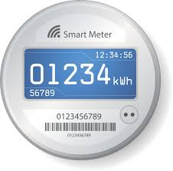
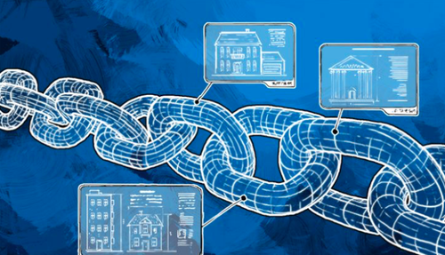
Security Assumptions
Billing is performed by the tamper proof smart meters based on the energy prices set by the DSO
The energy trades recorded in the blockchain, and
The energy transfer recorded by the smart meter
Regulatory policies are set by the DSO and cannot be changed by anyone else
Prosumers cannot back out of trades unilaterally, and they can be banned by the DSO

Slide 19
Privacy Guarantees
Only the corresponding smart meter and the DSO may gain information regarding the amount of energy produced, consumed, bought, or sold by a prosumer
Only the prosumer may know which bids and asks it has posted, and no one else can know who traded energy with whom

Slide 20
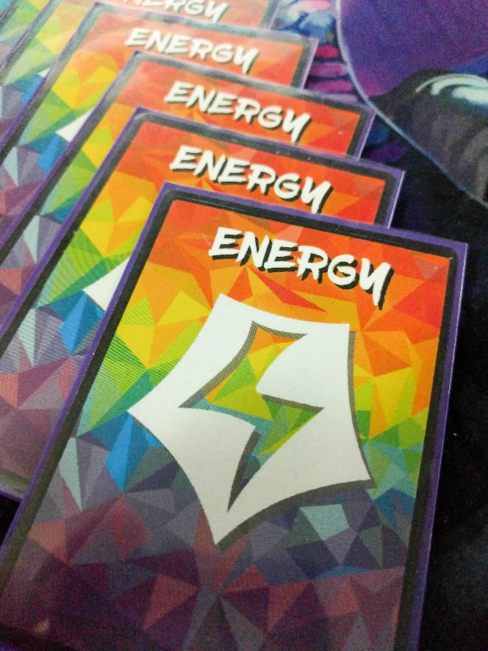
Energy Assets: PETra Key Concept
Energy is traded as quantized assets during fixed time intervals:
power: non-negative amount of power to be produced/consumed (for example, measured in watts)
start: first time interval in which energy is to be produced/consumed
end: last time interval in which energy is to be produced/consumed
A prosumer/consumer must withdraw assets from its smart meter before engaging in trading
selling energy → production asset
buying energy → consumption asset
Other assets are financial, which are exchanged after settlement of a trade

Slide 21
Energy Assets: PETra Key Concept
Energy is traded as quantized assets during fixed time intervals:
power: non-negative amount of power to be produced/consumed (for example, measured in watts)
start: first time interval in which energy is to be produced/consumed
end: last time interval in which energy is to be produced/consumed
A prosumer/consumer must withdraw assets from its smart meter before engaging in trading
selling energy → production asset
buying energy → consumption asset
Other assets are financial, which are exchanged after settlement of a trade
All transactions are recorded in the distributed ledger
auditable
immutable

Slide 22
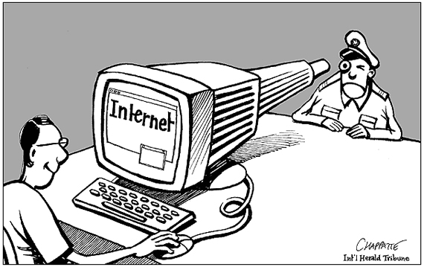
Privacy Problem
Transactions on Bitcoin and similar blockchains provide pseudo-anonymity
each transaction is associated with the public addresses of the sender and receiver, which enables tracking trades
anonymous addresses may be created
however, these addresses can be easily linked to the prosumers’ public addresses as soon as they transfer assets to them
Block
chain
All transactions are recorded in the distributed ledger
auditable
immutable

Slide 23
Solution: Mixing Services
Mixing services such as Zerocoin and Xim use accumulators and Zero Knowledge Proofs to mix transactions from a number of addresses together and then record them on the blockchain.
Due to this, it is not possible to identify the individual senders and link them to the anonymous addresses on the output
In PETra, we build on such a mixing service and use it to provide anonymity for trading
prosumer 1
prosumer 2
prosumer 3
mixing service
?
?
?
anonymous address 1
anonymous address 2
anonymous address 3

Slide 24
Full Trading Workflow (from Seller’s perspective)
Simplified overview of the flow of assets from the perspective of a prosumer who sells energy.
Note that to prevent de-anonymization, a prosumer should use multiple addresses and multiple rounds of mixing, which we have omitted from the figure for clarity of presentation.
DSO regulates using pricing and limiting asset withdrawals (using smart meters)
Tracking anonymous energy assets enables enforcing safety requirements (max capacities) without violating prosumer privacy

Slide 25
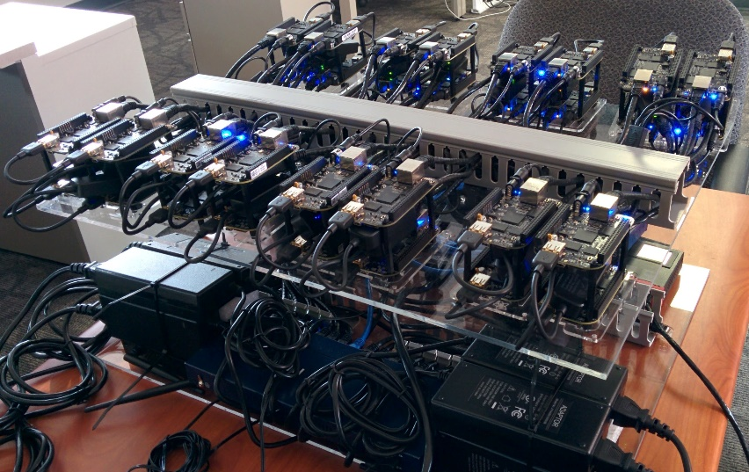
Evaluation
We used real-world energy production / consumption data from a German microgrid provided by Siemens, CT
We deployed our system on a private Ethereum network
90% of trades were closed within 23 seconds or less

Slide 26
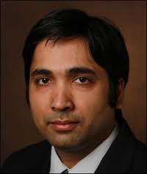

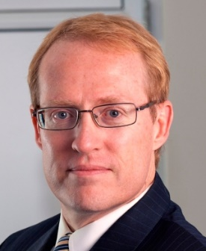

Summary
P2P Energy Trading in a Microgrid
Vanderbilt team
Conventional energy market
Energy Retailer, or DSO
Energy demand and surplus.
TM
PETra
TM
TM
P
P
TM
Prof. Abhishek Dubey
Prof. Aron Laszka
TM
P
TM
P
TM
P
TM
P
TM
P
TM
P
Prof. Douglas C. Schmidt
Mr. Scott Eisele (PhD Candidate)
TM
Transactive Meter
Information privacy
energy assets, anonymous addresses, and mixing services
Assuring integrity and auditability of finalized transactions
distributed ledger and tamper proof smart meters
URL: Scope.isis.Vanderbilt.edu
Email: abhishek.dubey@Vanderbilt.edu

